Slide 1

MATLAB Graphics: Improving the Plots
Professor Bo Liu
James Watt School of Engineering

Slide 2
Subplots
Create subplots using the “tiledlayout(m, n)” function:
  m: number of rows.
  n: number of columns.
Use the command “nexttile” to activate the next tile
  Any new plots will be placed onto the next tile.
Example: an object falling under gravity, creating the data:
  time = linspace(0, 10, 21);
  acceleration = 9.81 * ones(1, 21); % a = 9.81 m/s^2 (gravity)
  velocity = acceleration .* time; % v = a*t
  displacement = 0.5 * acceleration .* (time.^2); % s = 0.5*a*t^2
  tiledlayout(1,3) % creates empty plot, with 1 row and 3 columns
See live script

Slide 3
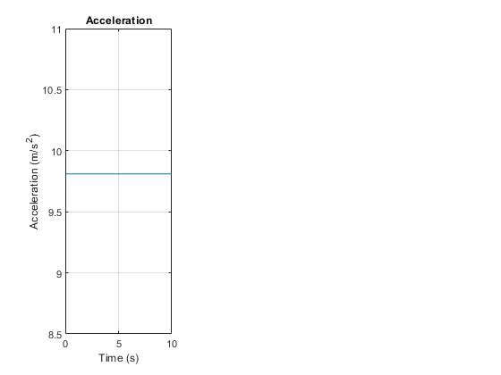
Example Subplots - 1
Plotting acceleration on the first subplot
nexttile % switch to first tile
plot(time, acceleration)
xlabel("time")
ylabel("Acceleration (m/s^2)")
title("Acceleration")
grid()
See live script

Slide 4
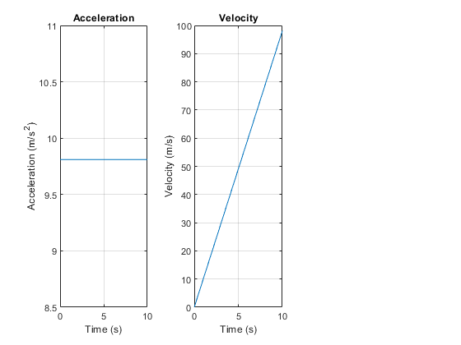
Example Subplots - 2
Plotting velocity on the second subplot
nexttile % switch to next tile
plot(time, velocity)
xlabel("time")
ylabel("Velocity (m/s)")
title("Velocity")
grid()
See live script

Slide 5
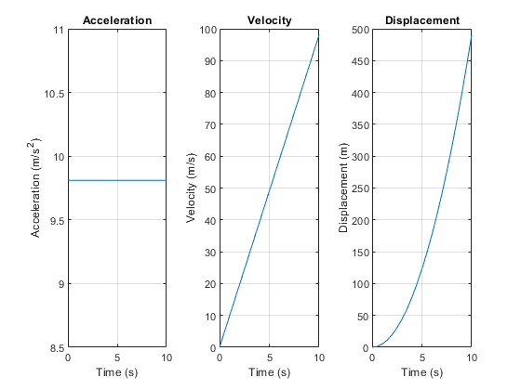
Example Subplots - 3
Plotting position on the third subplot
nexttile % switch to next tile
plot(time, displacement)
xlabel("time")
ylabel("Displacement (m)")
title("Displacement")
grid()
See live script

Slide 6
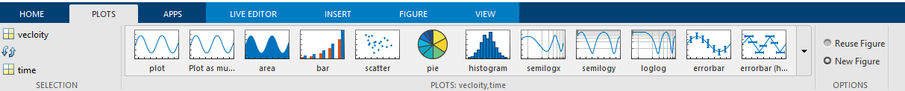
Plotting options
MATLAB allows customization of all aspects of the plot
  Dashed line: plot(x_data, y_data, '--').
  Red coloured line: plot(x_data, y_data, 'red').
  Red and dashed line: plot(x_data, y_data, ‘red--').
MATLAB can also recommend plots via “Plots” toolbar:
The easiest way to utilize this toolbar is by selecting the variables that are to be plotted in the workspace.
  MATLAB will then recommend compatible plots.

Slide 7
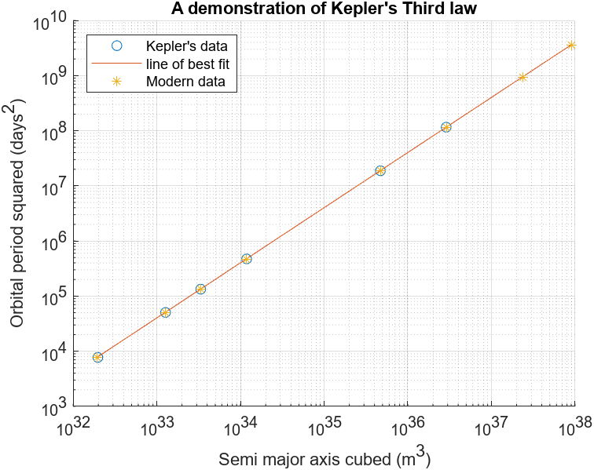
Example of Kepler's 3rd law
See case study

Slide 8
Other plot types
Other 2D plot types:
  Log–Log plots.
  Bar graphs.
  Pie charts.
  Histograms.
Read the documentation to learn more about 3D plot types
  Surface plots.
  Wireframe plots.
  Contour plots.
  Animations and movies.

Slide 9




Thanks!
#UofGWorldChangers
@UofGlasgow

